Slide 1
Summary of A Spatial Analysis of Multivariate Output From Regional Climate Models
Presented by Chris Chen & Yueqi Xu
Notes:
Intro

Slide 2
Table of contents
01
02
03
04
Goal
Background
Main research problem
Climate, Climate System, and Climate Model
Models
Results
MRF, CAR, multivariate Hierarchical model
Experimental results

Slide 3
01
Goal
To study climate and to conquer the challenge of characterization of distribution of RCM output

Slide 4
Key points
Focus & significance:
On the projected change in seasonal temperatures and precipitation over the next 50 years. Global warming? Natural disasters? We need to get prepared.
Challenge:
RCMs are usually ensembles of models, which include tons of parameters, hence the estimation is very computationally expensive
Why ensemble? Because climate is largely unpredictable and heavily dependent on initial conditions. We need to take into account all sources of uncertainties.
Notes:
In order to capture the range of variation in the model output, there is an increasing use of ensembles consisting to multiple model runs. These experiments may involve one of the presented ensembles, or some combinations of them.

Slide 5
02
Background
Climate, Climate System, and Climate Model

Slide 6
Definitions
Climate:
The long-term distribution of weather.
Climate System:
Atmosphere, oceans, terrestrial, marine biospheres, sea ice, etc.
Climate Model:
Climate system + human intervention
Notes:
In order to capture the range of variation in the model output, there is an increasing use of ensembles consisting to multiple model runs. These experiments may involve one of the presented ensembles, or some combinations of them.

Slide 7
Climate models
Planetary CMs:
Relatively well developed, because of (almost) unlimited budget and lower dependence on planetary level.
Regional CMs:
Relatively worse developed, because we have limited budget, higher difficulty due to large dependencies, yet we require them to have high accuracies.
Local CMs:
Relatively well developed, because of smaller volume of data and lower requirement on accuracy.
Notes:
In order to capture the range of variation in the model output, there is an increasing use of ensembles consisting to multiple model runs. These experiments may involve one of the presented ensembles, or some combinations of them.

Slide 8
03
Models
MRF, CAR, multivariate Hierarchical model

Slide 9
MRFs and CARs
Markov Random Field Key features:
Great for data laid out on spatial lattice data
Represent the conditional expectation of an observation at a spatial location as a linear combination of observations at neighbouring locations
Conditional AutoRegressive Models:
Special MRF where the conditional distributions are assumed to be Gaussian.

Slide 10
An alternative formulation of MRF
Key features:
“Stacking” of the lattices associated with each variable, so it still falls within the original univariate framework, but can predict more than one variable simultaneously.

Slide 11
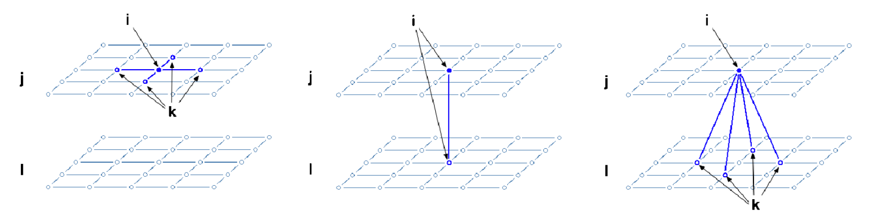
An alternative formulation of MRF
New neighbors:
Connections between locations for each variable within each lattice + locations across each lattice structure
Within variable dependencies within location cross dependencies across locations cross dependencies

Slide 12
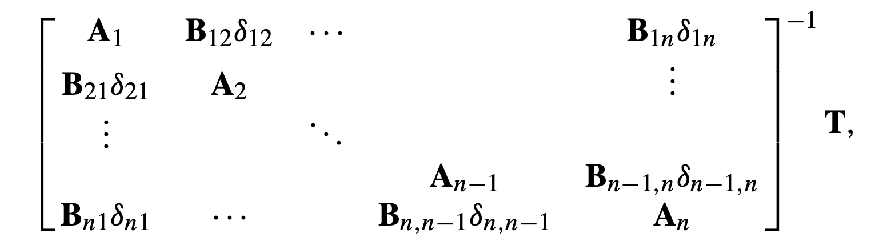
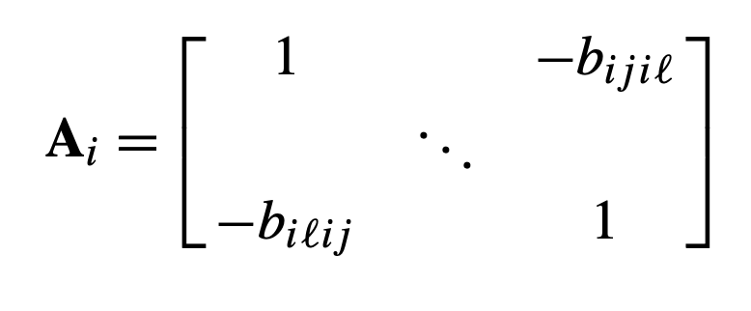
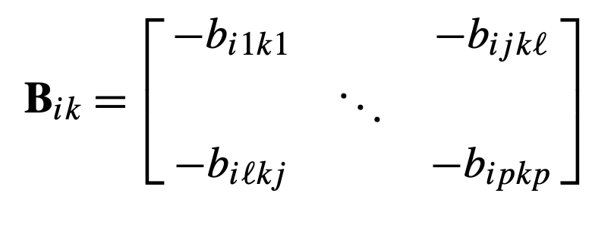
New Gaussian Joint Distribution
Mean: μ = [μ′1 , . . . , μ′n ]′ and μi = [μi1, . . . , μip]′
Covariance Matrix:
T= diag(τ11² , . . . , τ1p², . . ., τn1², . . ., τnp²)
𝛿ik = 𝛿ki = 1 if i ~ k, 0 otherwise

Slide 13
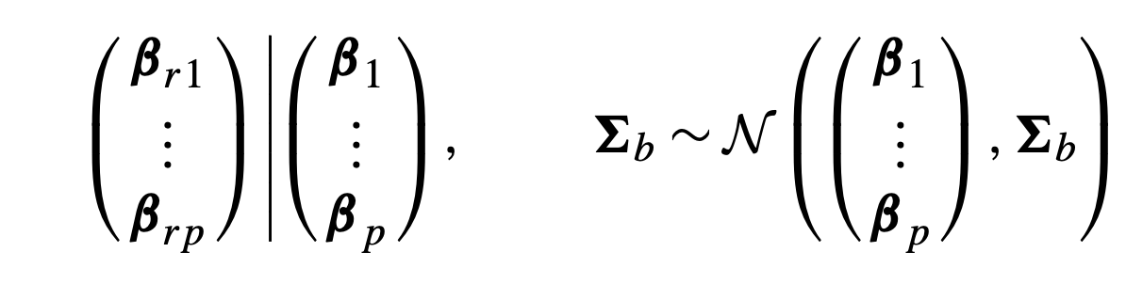
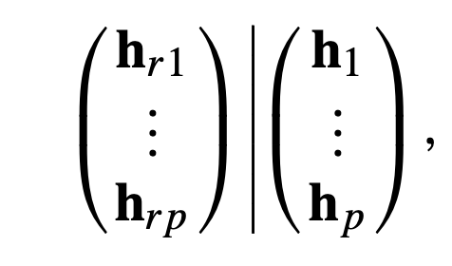
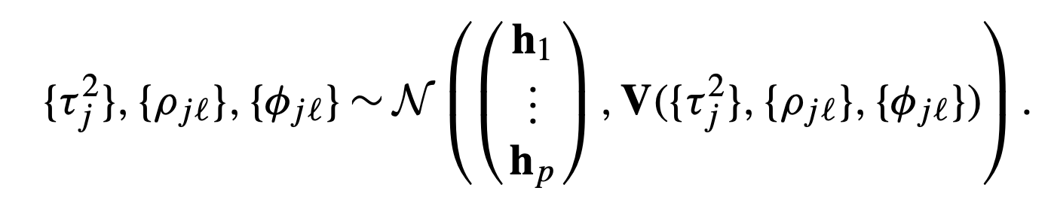
Hierarchical model for RCM experiments
Data model:
Process model:

Slide 14
Parameter Model and Priors
Parameter model:
σj, αj, βj, hj, and Σb
τj², ρ, and φij
Informative priors lead to biased estimates → noninformative (and independent) priors are assigned
Priors:
P (σ²) ∝ 1/σ²
αj ~ N(0, 10Ip), βj ~ N(0, 100Ip), hj ~ N(0, 10Ip)
ρ, φij ~ Unif(range of values that gives a positive definite covariance matrix)

Slide 15
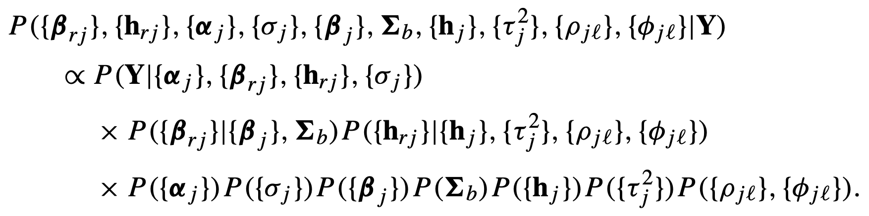
Posterior Distribution
Has no closed form, so we use MCMC to sample from the Posterior Distribution
Gibbs Sampling + Metropolis-Hastings steps while needed

Slide 16
04
Results
Experimental results

Slide 17
Experiment Design
n = 44 ⨯ 56 = 2464: 2464 grid boxes on a regular lattice
p = 2: seasonal temperature and precipitation
m = 3: 3 ensemble members

Slide 18
Winter
First Regime:
2500 iterations
Conditional dependent variables were updated one at a time
Proposal variance updated to achieve ~20% acceptance rate
Second Regime:
10,000 iterations
ρ, φ12, and φ21 were updated simultaneously
φ11, and φ22 were updated one at a time
Proposal covariance matrix updated to achieve ~20% acceptance rate
Third Regime
Same as the second regime
No further updates to the proposal distribution
Notes:
In the experiment, a Gibbs sampler was implemented with three regimes, the general structure is listed as follows. The parameters were updated using a Metropolis-Hasting algorithm, and gaussian proposal distributions were used. The estimated posterior mean and posterior standard deviation for ρ is −0.12 and 0.014, respectively. A negative value for ρ suggests that an increasing temperature is (conditionally) associated with a decreasing total precipitation.

Slide 19
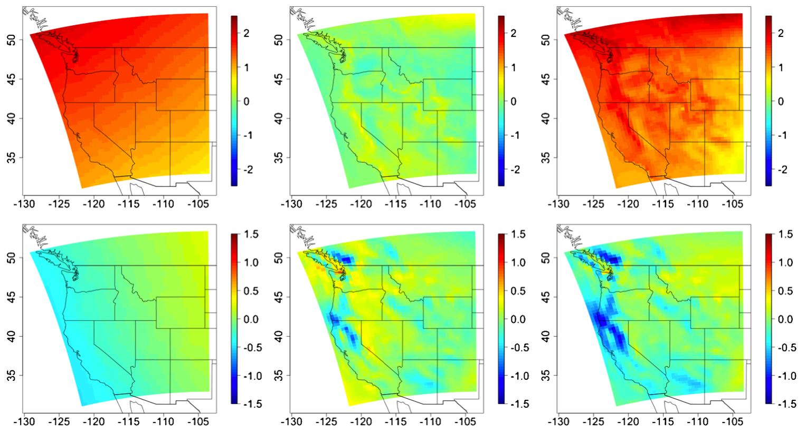
Winter
Change in midpoint temperature
Change in total precipitation
Posterior Means (Fixed Effect)
Spatial Effect
Sum
Notes:
This plot shows the posterior mean for the winter season. The fixed effects show a clear east to west gradient, while the spatial effects seem to follow the feature of a topography, In general, the spatial effects for change in temperature have a smaller magnitude than the fixed effects, while in contrast, the spatial effects of precipitation is slightly higher. The sum of the two effects for temperature shows a consistent pattern of winter warming on average throughout the west, while the sum for precipitation is much more localized. For example, we can see there’s a sharp decline in northern California.

Slide 20
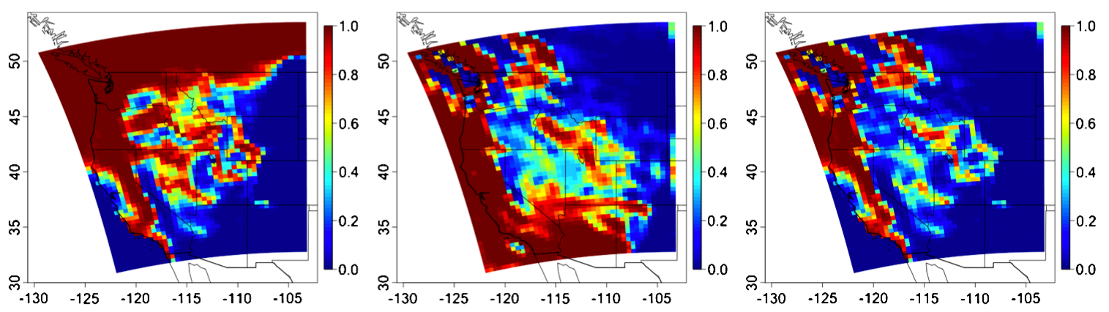
Winter
Simultaneously increasing temperature and decreasing total precipitation
Increasing temperature
Decreasing total precipitation
Notes:
This plot shows the estimated pointwise probabilities. Again, it provide evidence of widespread increase in temperature and decrease in total precipitation across the western U.S.

Slide 21
Summer
First Regime:
2500 iterations
Conditional dependent parameters were updated one at a time
Proposal variance updated to achieve ~20% acceptance rate
Second Regime:
20,000 iterations
ρ, φ11, φ12, φ21, and φ22 were updated simultaneously
Proposal covariance matrix updated to achieve ~20% acceptance rate
Third Regime
10,000 iterations
ρ, φ11, φ12, φ21, and φ22 were updated simultaneously
No further updates to the proposal distribution
Notes:
The Gibbs sampler for the summer season has a similar structure in general, with some small differences in detail. The number of iterations in the second regime is doubled. In addition, all five conditional-dependence parameters were updated simultaneously, instead of only three. The posterior mean of ρ is −0.41, which suggests that the summer season has a much stronger negative correlation between the change in temperature and the change in total precipitation.

Slide 22
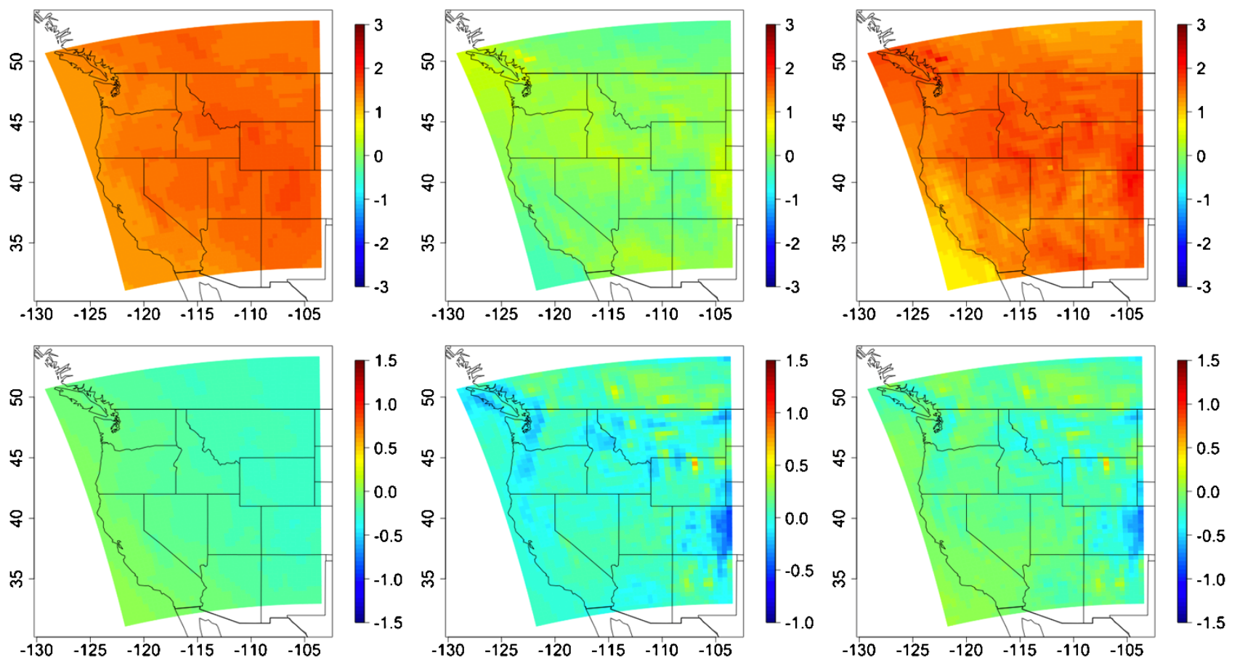
Summer
Change in midpoint temperature
Change in total precipitation
Posterior Means (Fixed Effect)
Spatial Effect
Sum
Notes:
This plot shows posterior means for the summer season. Now, the general trends in fixed effects appear to be west-to-east. And again, for temperature, the spatial random effects are of smaller magnitude than the fixed effects. The sum for temperature shows a consistent pattern of summer warming on average throughout the west, while the sum for total precipitation again shows patterns that are much more localized

Slide 23
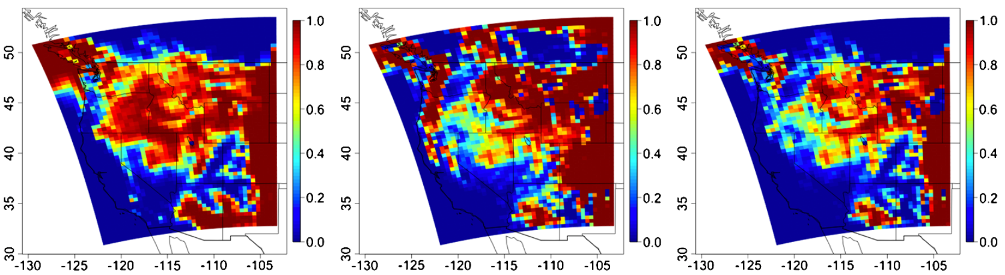
Summer
Simultaneously increasing temperature and decreasing total precipitation
Increasing temperature
Decreasing total precipitation
Notes:
As for winter, this figure shows estimated pointwise probabilities for summer. In general, summer warming and decreasing total precipitation focused more on the eastern side of the domain.

Slide 24
Thanks
Do you have any questions?
your email@freepik.com
+91 620 421 838 yourcompany.com
Please keep this slide for attribution

